Slide 1
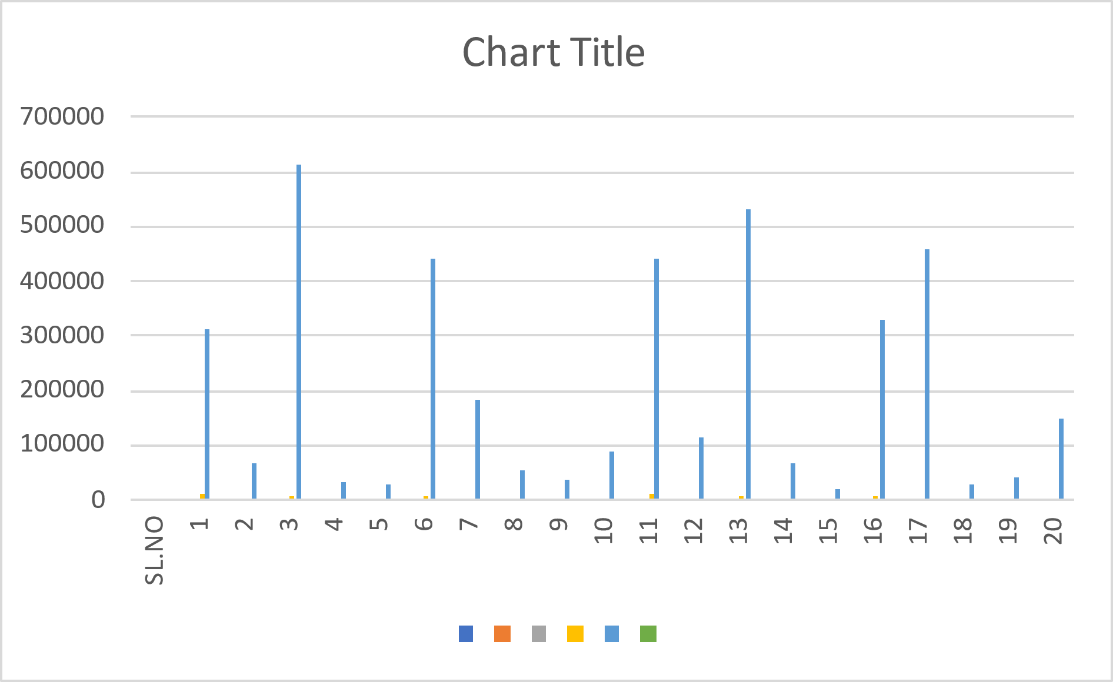
Employee name | Item | Quality | Rate | Amount
Amith | LED | 32 | 9800 | 313600
Raj | RAM | 45 | 1500 | 67500
Rakesh | LCD | 75 | 8200 | 615000
Jay | Keyboard | 65 | 525 | 34125
Nirmal | Mouse | 125 | 220 | 27500
Nishchith | UPS | 80 | 5500 | 440000
Sofiya | HDD | 60 | 3050 | 183000
Arun | Pend drive | 150 | 350 | 52500
Diya | Web Cam | 80 | 450 | 36000
Suraj | Speaker | 95 | 950 | 90250
Rohan | LED | 45 | 9800 | 441000
Maya | RAM | 75 | 1500 | 112500
Mukesh | LCD | 65 | 8200 | 533000
Nagesh | Keyboard | 125 | 525 | 65625
Bhuvan | Mouse | 80 | 220 | 17600
Lokesh | UPS | 60 | 5500 | 330000

Slide 2
EXPLANATION
1. Amith and Rohan both sold LED items, with Amith's sale amounting to 313,600 and Rohan's sale amounting to 441,000.
2. Raj and Maya both sold RAM, with Raj's sale generating 67,500 and Maya's generating 112,500.
3. Rakesh and Mukesh sold LCD items, with Rakesh earning 615,000 and Mukesh earning 533,000.
4. Jay and Nagesh sold keyboards, with Jay's sale totaling 34,125 and Nagesh's totaling 65,625.
5. Nirmal and Bhuvan sold mice, with Nirmal's sale amounting to 27,500 and Bhuvan's amounting to 17,600.
6. Nishchith and Lokesh both sold UPS units, with Nishchith earning 440,000 and Lokesh earning 330,000.
7. Sofiya sold HDD for 183,000 and Arun sold pen drives for 52,500.
8. Diya sold webcams for 36,000 and Suraj sold speakers for 90,250.

